Slide 1

Data Science Project
~ Finance Domain

Slide 2
CONTENTS
Table of Contents
Introduction
Project Roadmap
Data Preprocessing
EDA - Exploratory Data Analysis
EDA Data Visulisation - Transformed Data
7. Statistical Representation
8. MI Models
9. Model Evaluations

Slide 3

Introduction
Objective: Build a robust pipeline for analyzing
financial data.
Problem Statement:
Recovery and Identifying Statute-Barred
Accounts Using Machine Learning
Key Deliverables:
Data Preprocessing
Feature Engineering
Model Development
Challenges:
Handling missing values
Generating derived features
Balancing the dataset

Slide 4
Project Roadmap
1.Data Preprocessing
2. EDA
ML Models
Data Cleaning
Statistical Analysis
Building Models
Handling Missing Data
Cleansing of Data
Data Manipulation
EDA Goals
Statiscal Insights
Feature Analysis
Machine Learning Models
Binary Classification Models

Slide 5

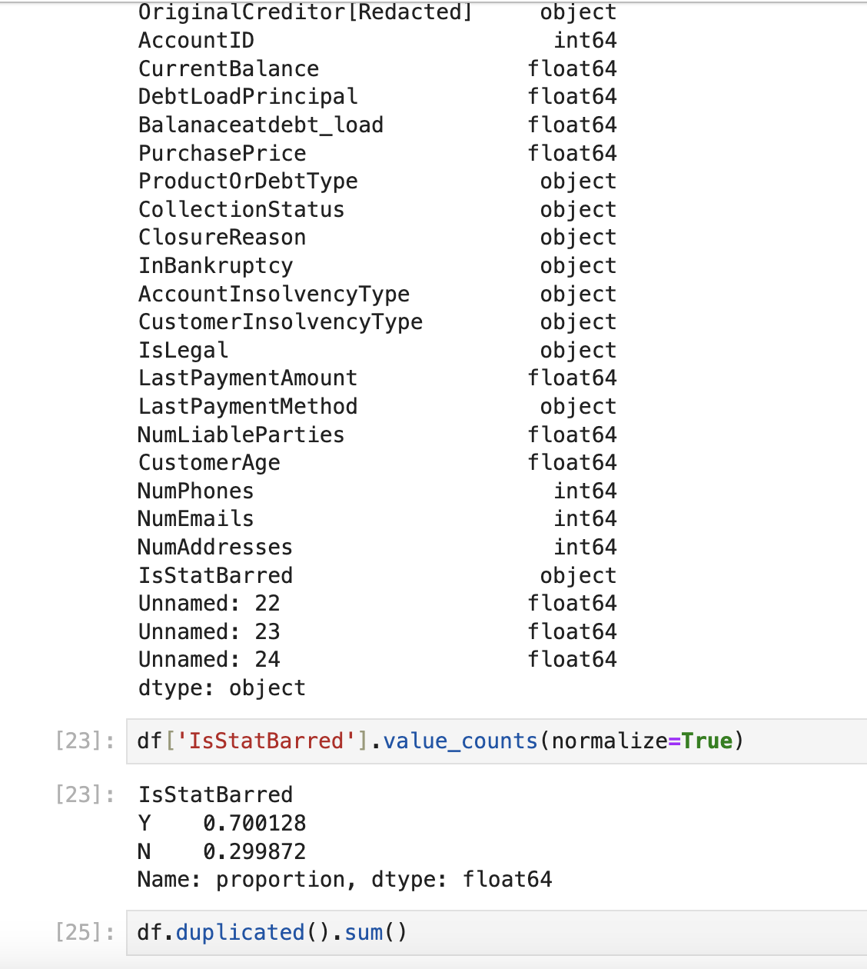
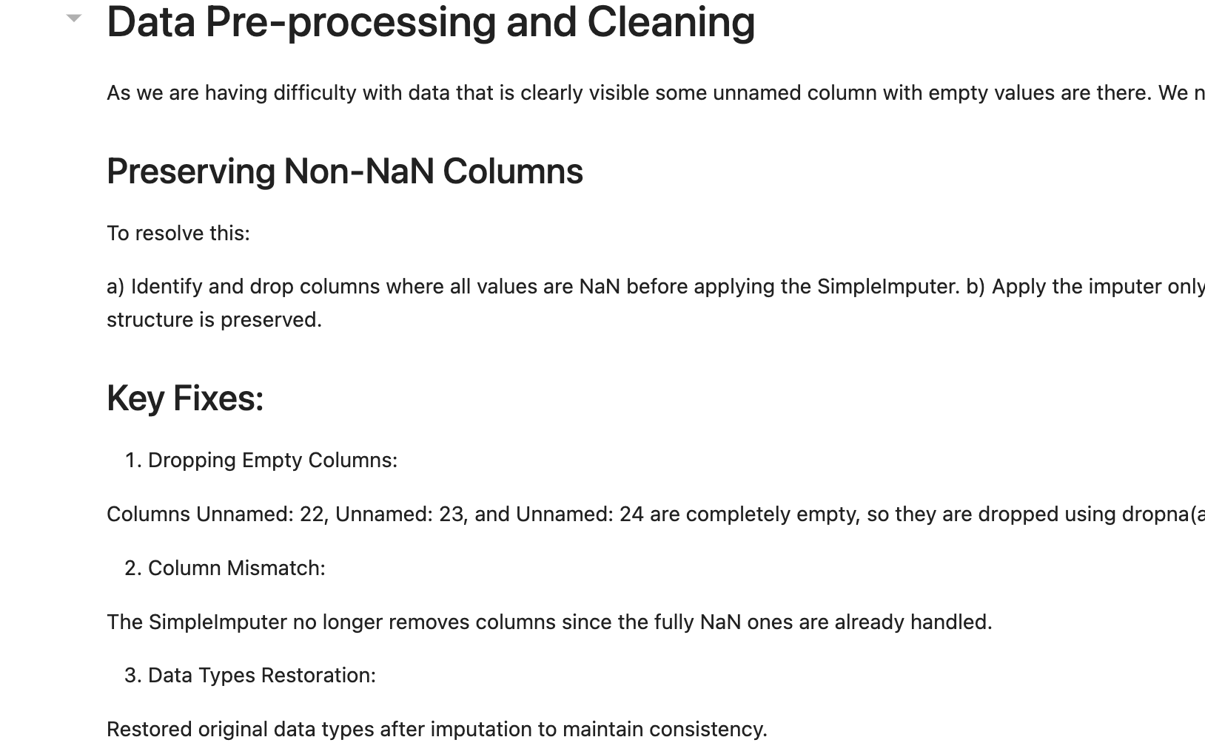
Data Preprocessing
- Handling Missing values with SimpleImputer.
- Standardizing numerical features using StandardScaler.
- Encoding categorical features with OneHotEncoder.
- Verifying consistency and integrity of data post-cleaning.

Slide 6

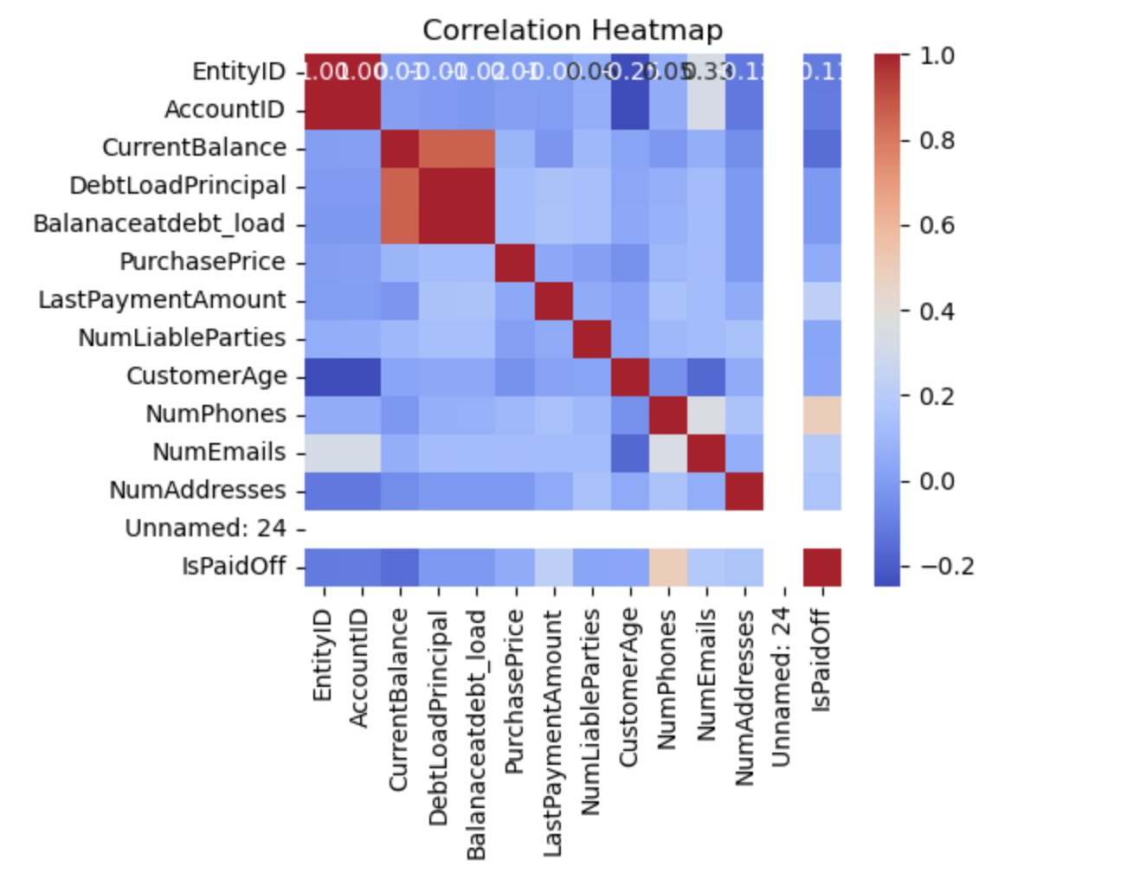

EDA - Exploratory Data Analysis
EDA Goals:
- Understand data distribution.
- Identify correlations and trends.
- Detect missing values.
Key Insights:
- Histograms for numerical data.
- Scatterplots and correlation heatmaps.
EDA Representation:
Visualize relationships, e.g., DebtLoadPrincipal vs. Balanceatdebt_load.

Slide 7
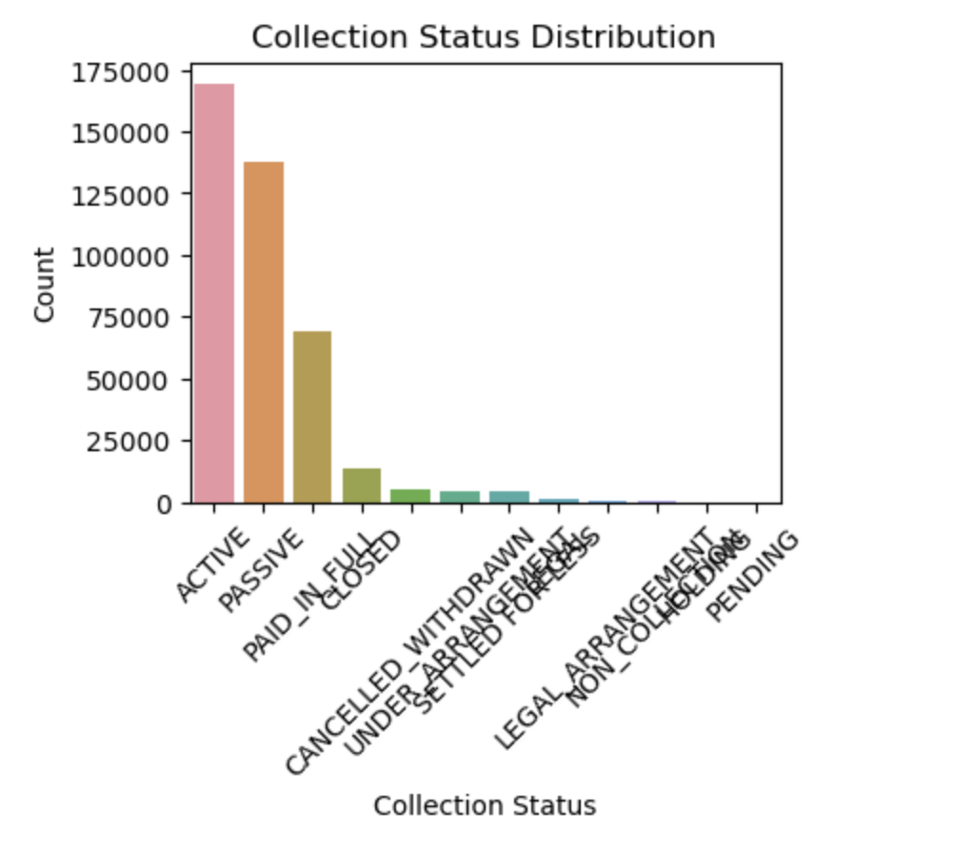
EDA Data Visulisation - Transformed Data
Data Transformation:
Scale numerical features using StandardScaler or MinMaxScaler.
Address class imbalance for IsStatBarred using techniques like SMOTE or ADASYN.

Slide 8
Feature Engineering
Overview
Purpose: Enhance model performance by adding domain-relevant features.
Examples:
DebtAge: Time since PurchaseDate.
LoadToPurchaseDays: Gap between LoadDate and PurchaseDate.
Interaction Terms: InterestRate × DebtLoadPrincipal.
Key Challenges: Missing date columns, synthetic feature generation.

Slide 9
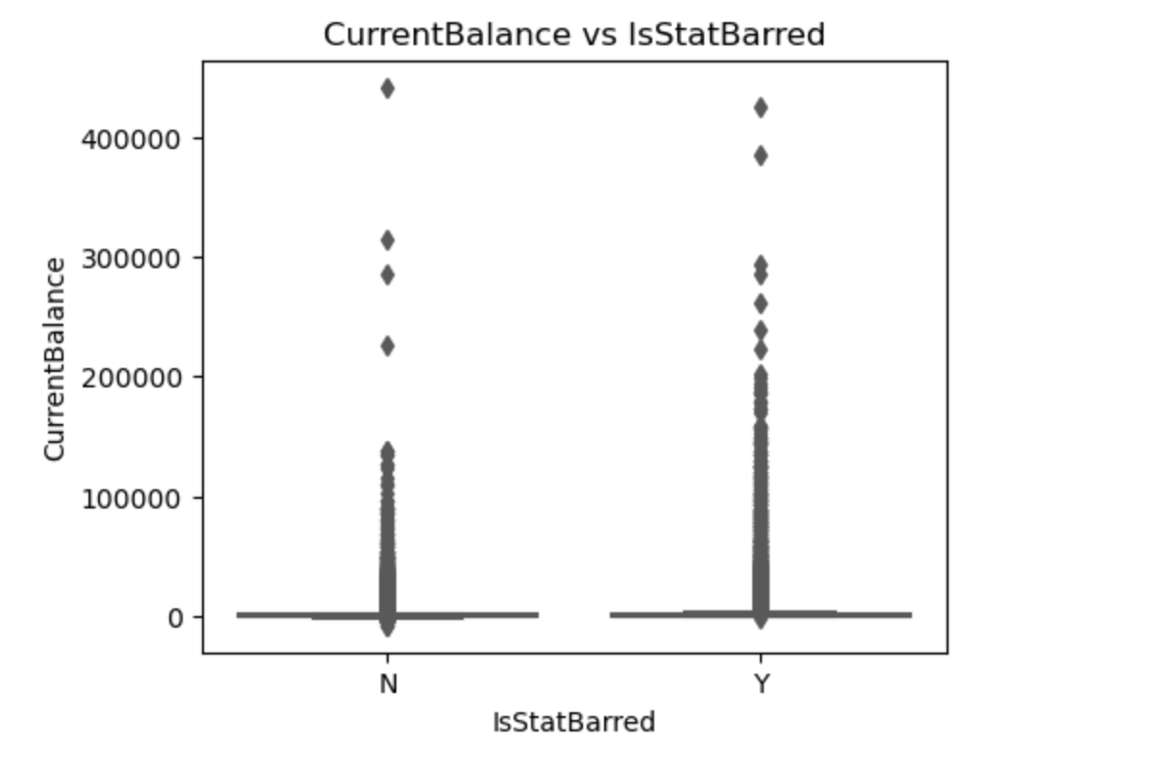
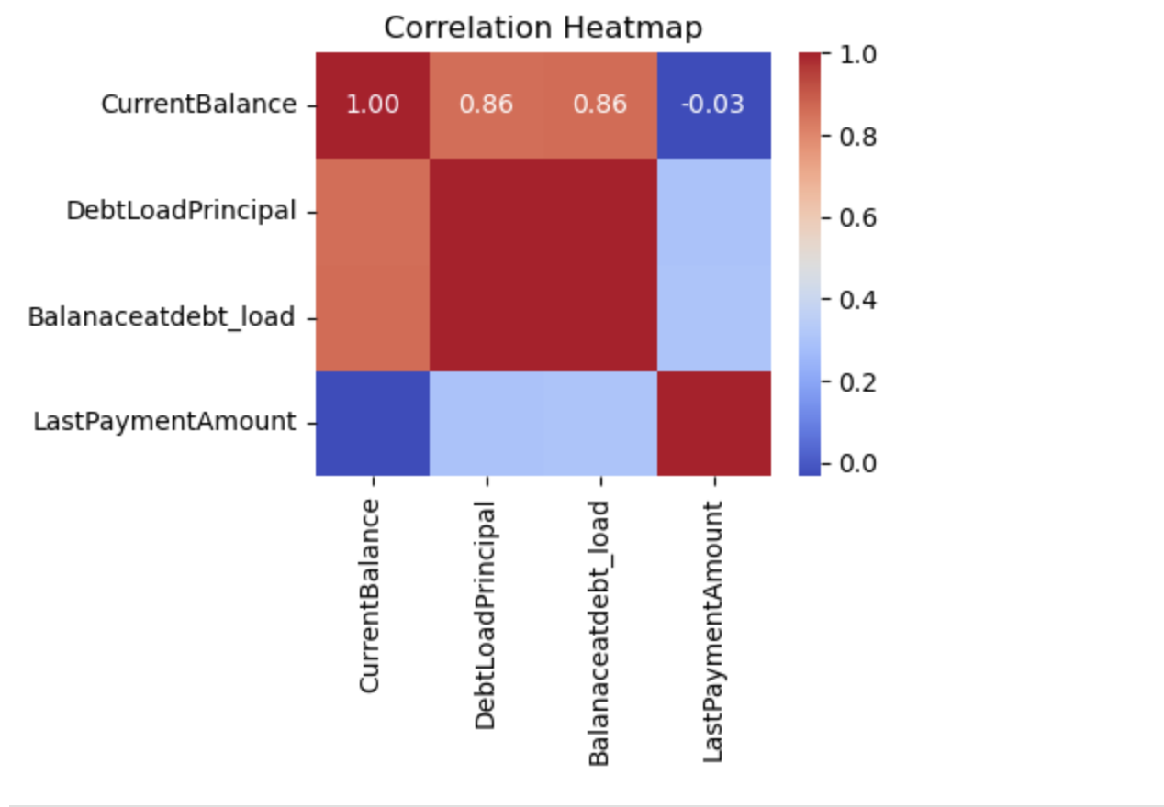


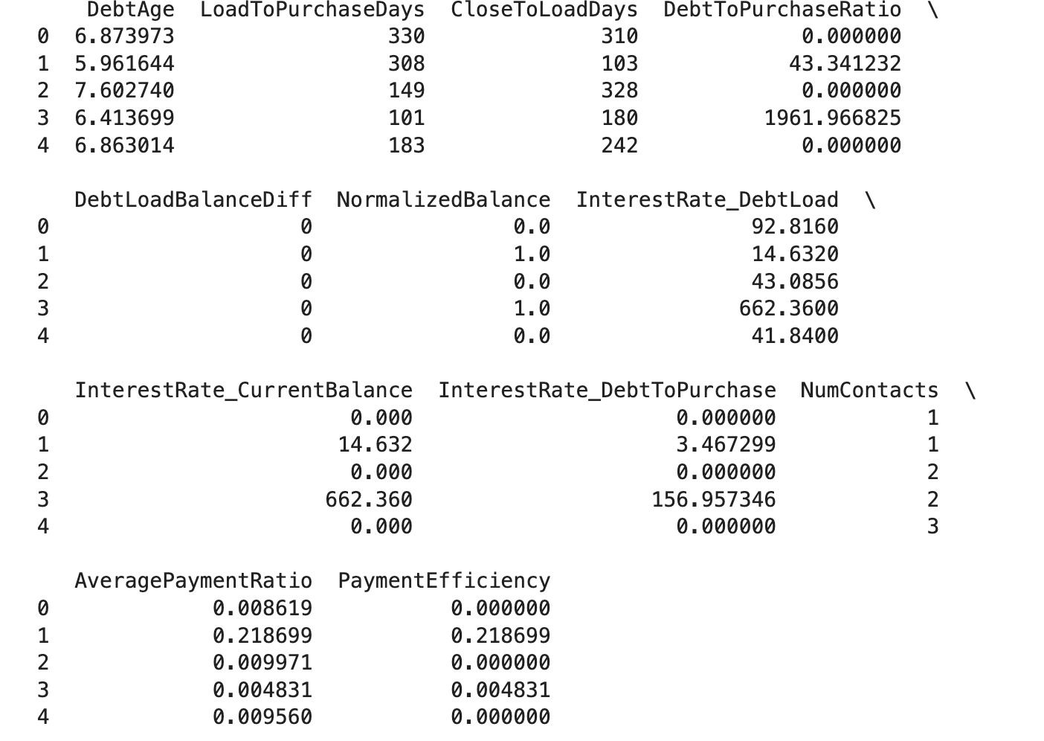
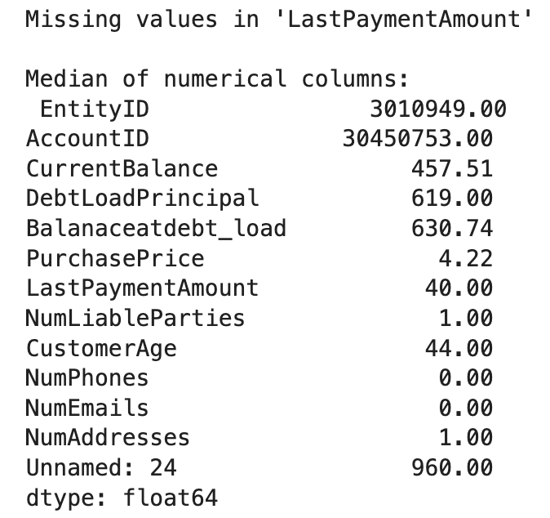
Statistical Representation
Variable Analysis
Add Your Title
Add Your Title
Add Your Title
Derived Category Statistics
Add Text Add Text Add Text Add Text Add Text Add Text Add Text
Add Text Add Text Add Text Add Text Add Text Add Text Add Text

Slide 10

ML Models
Linear Regression Models
Linear Regression, Lasso etc.
Binary Classification Models
Support Vector Machine, k-Nearest Neighbors, Logistic Regression Regression etc.

Slide 11

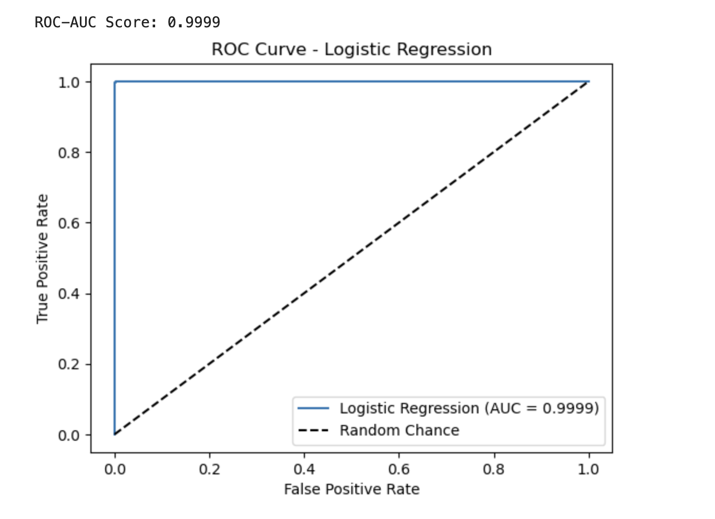
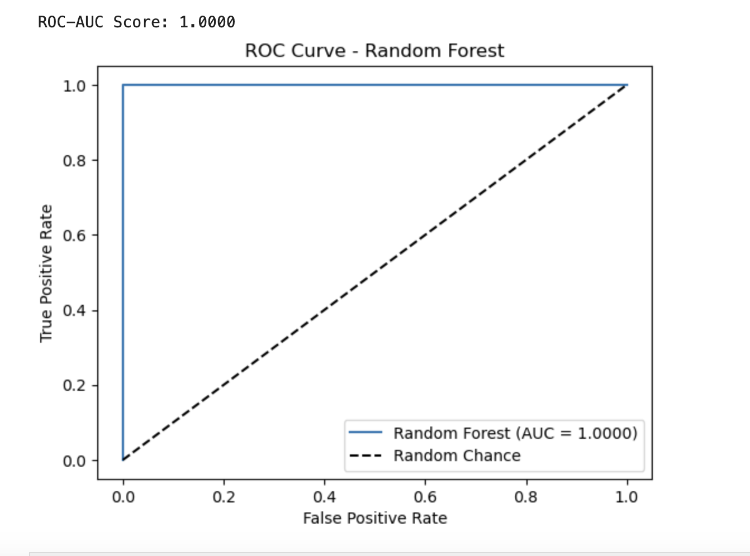
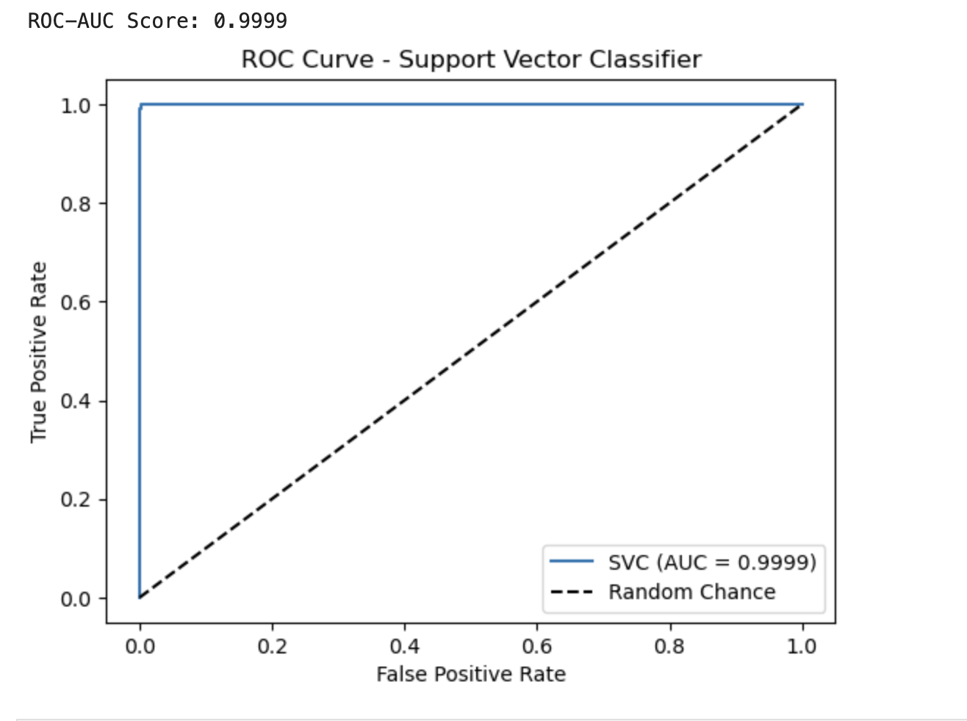
ML Models
Model Evaluation
ROC Curves for various models
WPS

Slide 12
Thank You
Date: 14-12-2024

